Slide 1

Forests 2020:
Prediction of Forest Canopy Index Using Support Vector Machine
Presented by
Sahid Hudjimartsu

Slide 2
Decision Tree:

Slide 3
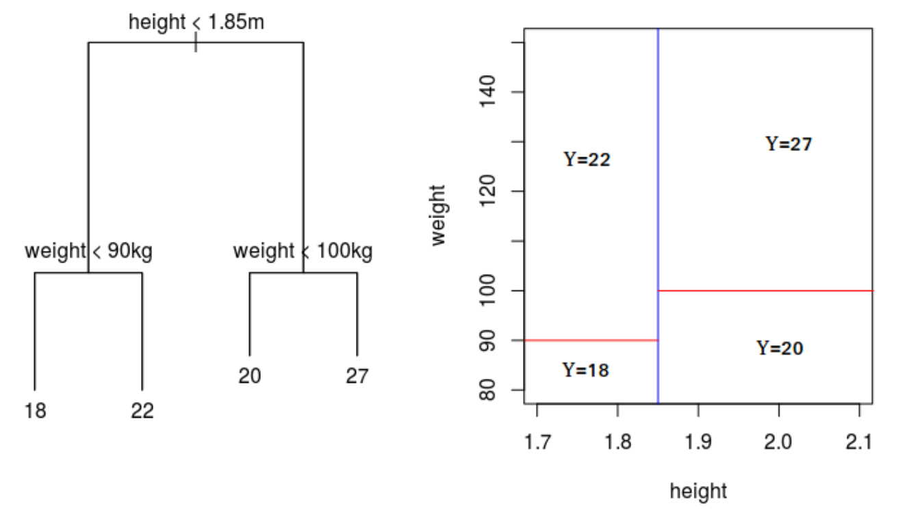
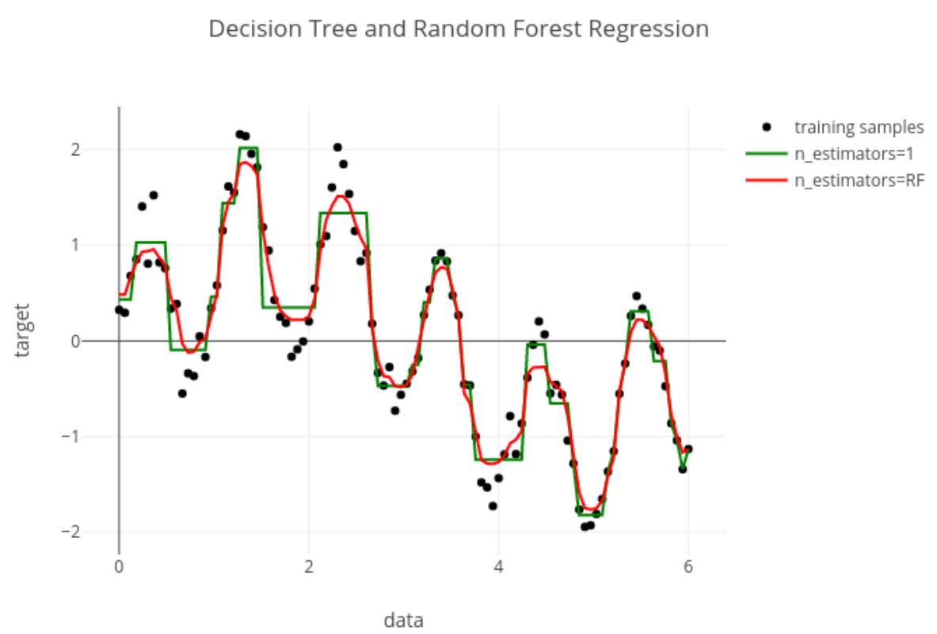
Random Forest Regression:
Regression

Slide 4
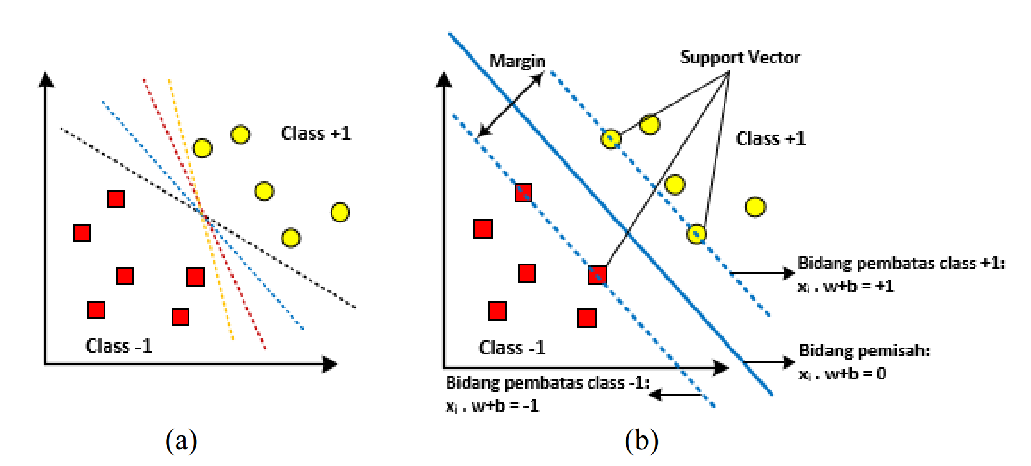
Support Vector Machine:
Classification

Slide 5
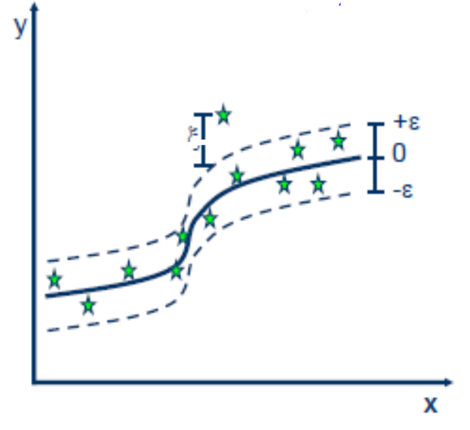
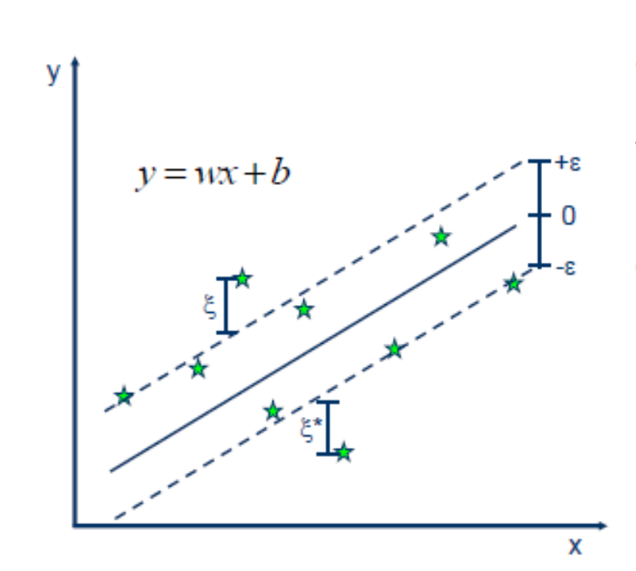
Regression
Linear Vs Non-Linear

Slide 6
FRCI on Agroforestry (Cidanau)
FRCI calculated using LiDAR data
300 Sample data
Divide Data (Training and testing data)
Normalisasi Data (Feature Scaling)
K-fold cross validation
Model predicted using SVR (Support Vector Regression)

Slide 7
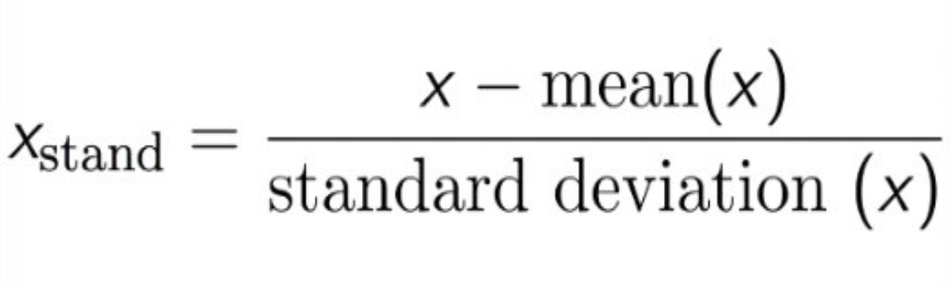
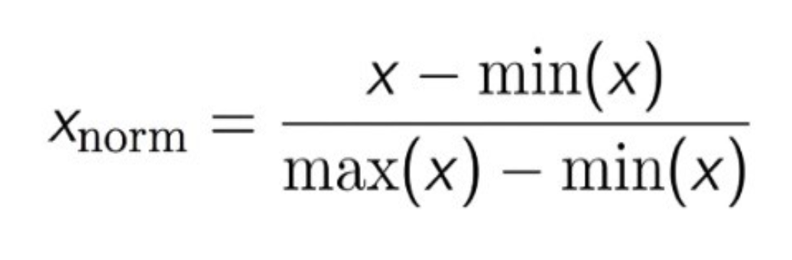
Normalisasi Data with StandardScaler
http://benalexkeen.com/feature-scaling-with-scikit-learn/
https://scikit-learn.org/stable/modules/generated/sklearn.preprocessing.StandardScaler.html

Slide 8
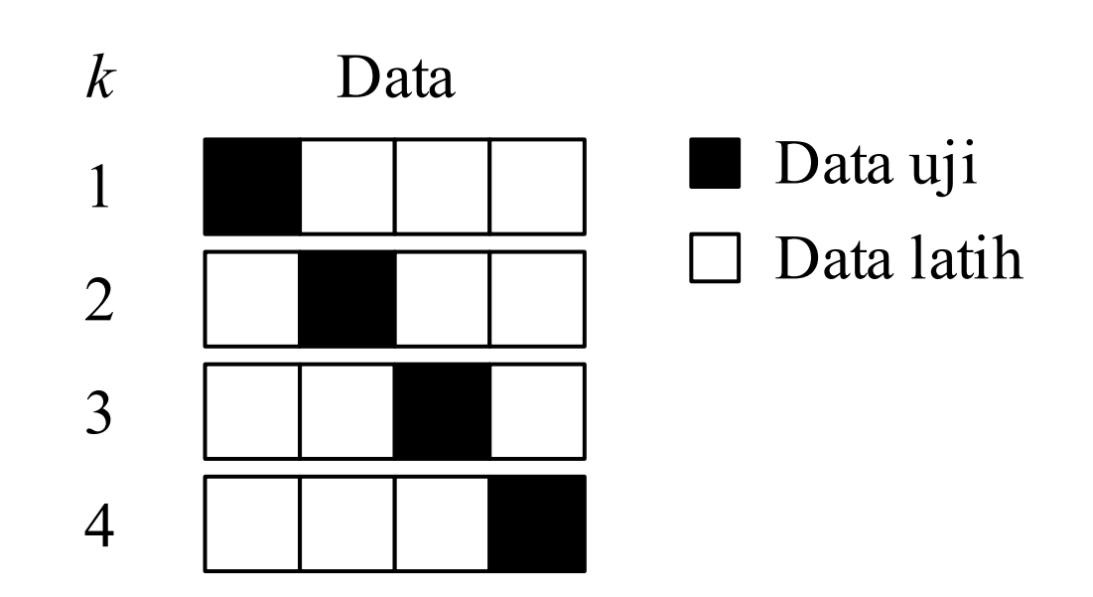
K-Fold Cross Validation

Slide 9
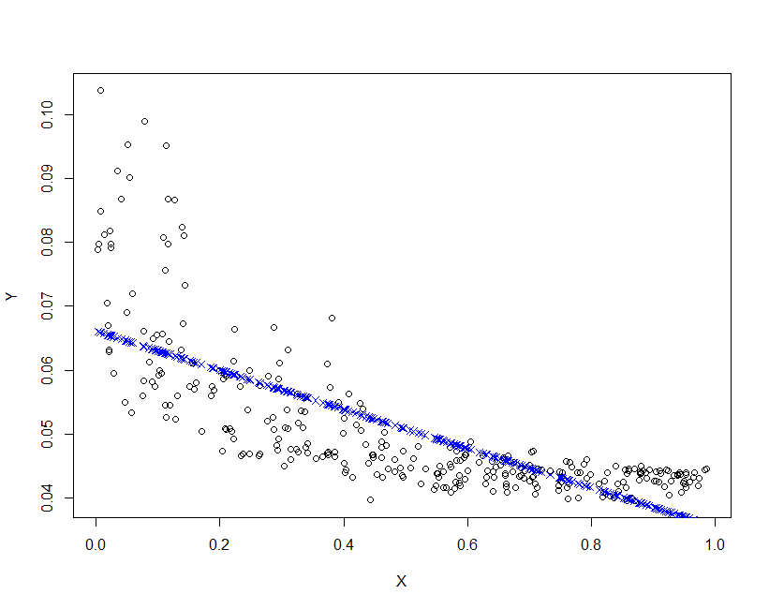
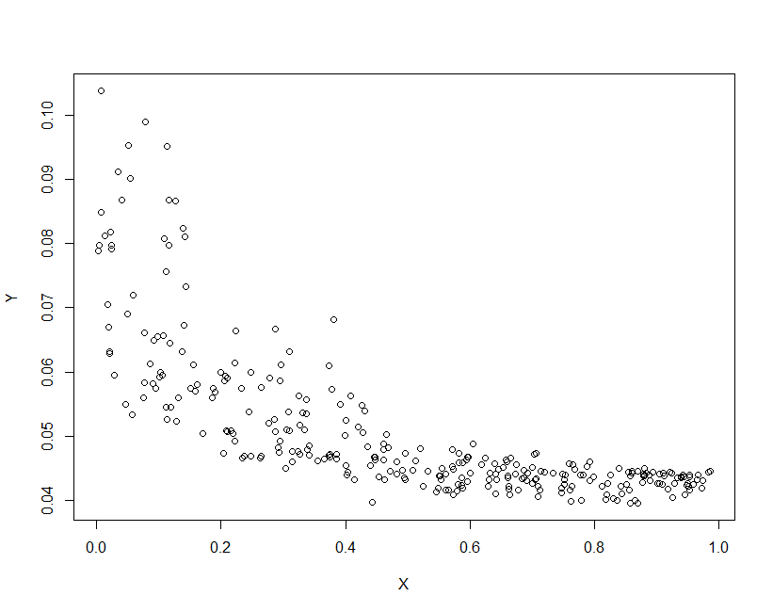
Prediction Model…[1]
Linear Model
RMSE : 0.008028042
FRCI VS Band 4

Slide 10
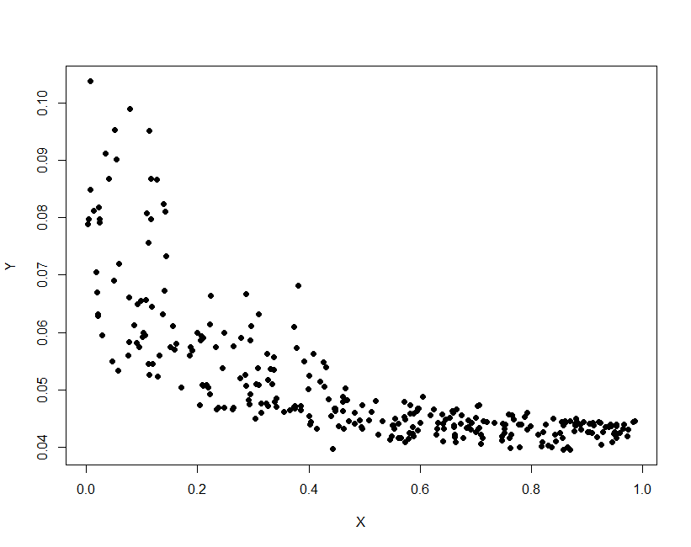
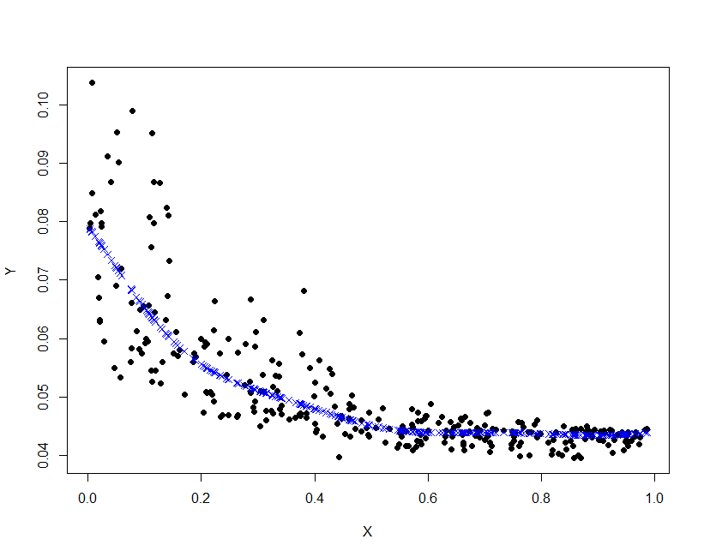
Prediction Model…[2]
SVM
RMSE :0.00645505

Slide 11
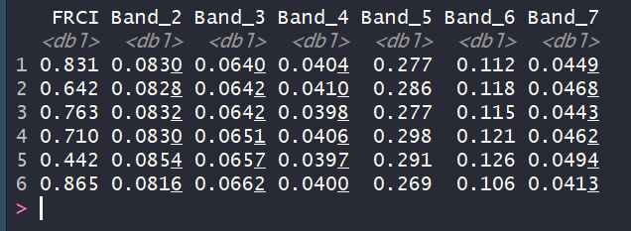
Prediction Model…[3]
SVM
RMSE :0.1188936

Slide 12
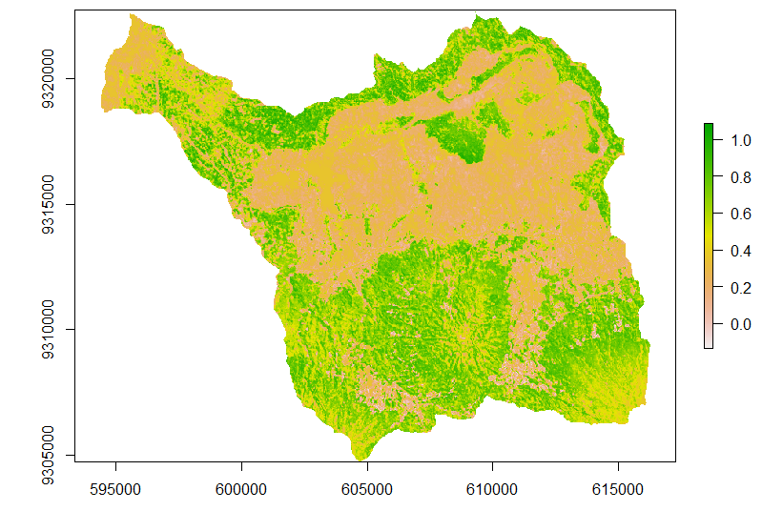
Prediction Map of FRCI

